Slide 1




Guided Image Filtering
Shang Gao

Slide 2





Outline
Introduction
Guided Image Filtering
Analysis
Improvements & Conclusions

Slide 3


Introduction

Slide 4
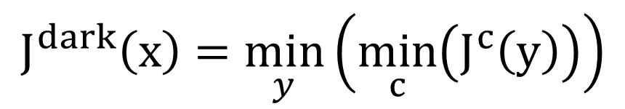
Recall: Dark Channel Prior
Darkest
For an image J, define:
15 x 15 patch
$$J^{dark}\left(x\right)=\min_{y}\left(\min_{c}\left(J^{c}\left(y\right)\right)\right)$$
Input Image
min (r, g, b)
Dark Channel

Slide 5
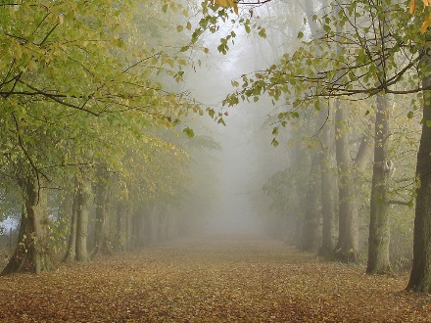
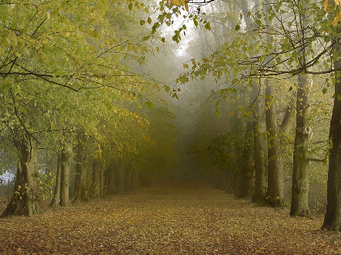
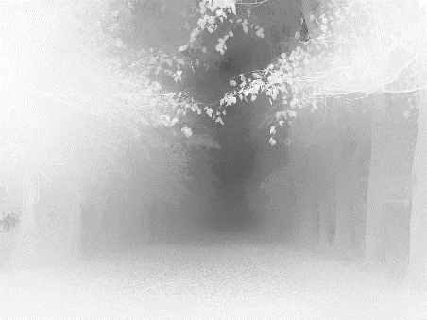
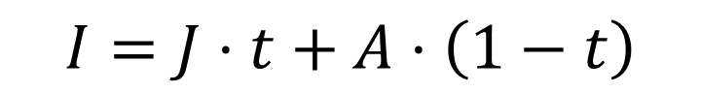
Recall: Haze Imaging Model
$$I=J⋅t+A⋅\left(1−t\right)$$
Atmospheric light
Hazy Image
Scene radiance
(Haze Free Image)
Transmission
● Transmission: 描述无法散射并到达照相机的光的介质传输率

Slide 6
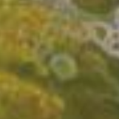
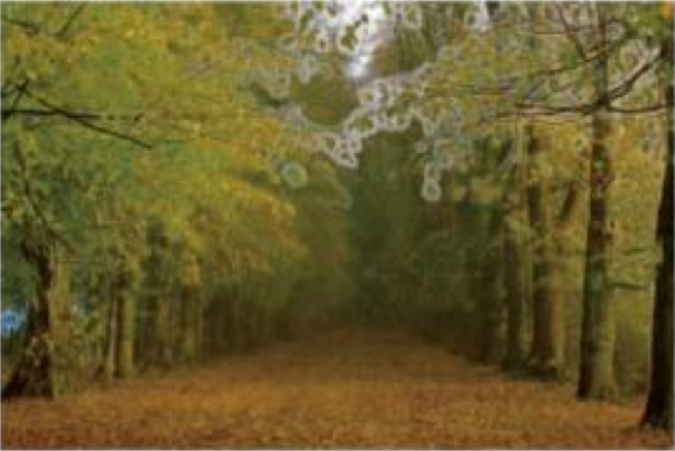
Recall: Soft Matting
Contains some block effects since the transmission is not always constant in a patch.
Input I
Estimated t
Haze Free Image J

Slide 7

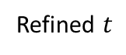
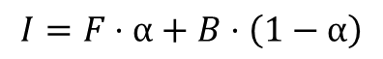
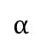
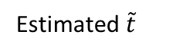
Recall: Soft Matting
Haze imaging model
$$I=J⋅t+A⋅\left(1−t\right)$$
Matting model [Levin et al., CVPR ‘06]
$$I=F⋅α+B⋅\left(1−α\right)$$
Input I
+
tri-map
$$α$$
Input I
Estimated $\tilde{t}$
Refined $t$

Slide 8
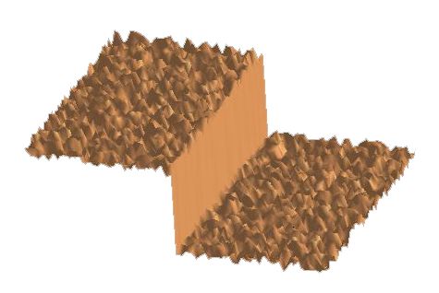
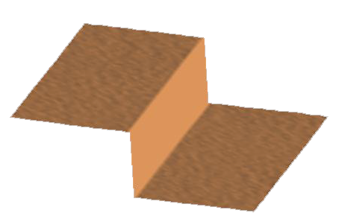
Edge-Preserving Filtering
Box filter/Gaussian filter:
Erase some of the detail and reduce the performance of the edge in the picture, while smoothing the effects of noise
Bilateral filter:
Smooth the image while preserving edges

Slide 9
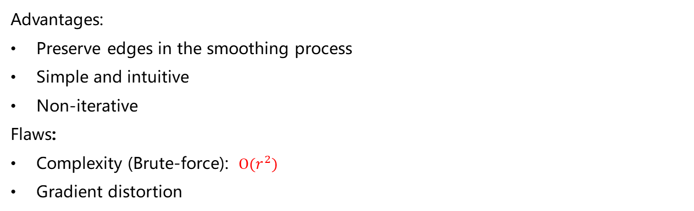
Bilateral Filtering
Advantages:
Preserve edges in the smoothing process
Simple and intuitive
Non-iterative
Flaws:
Complexity (Brute-force): $O(r^{2})$
Gradient distortion

Slide 10

Guided Image Filtering

Slide 11
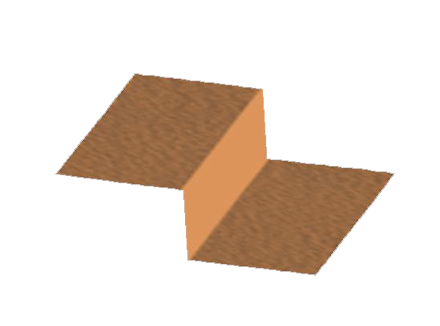

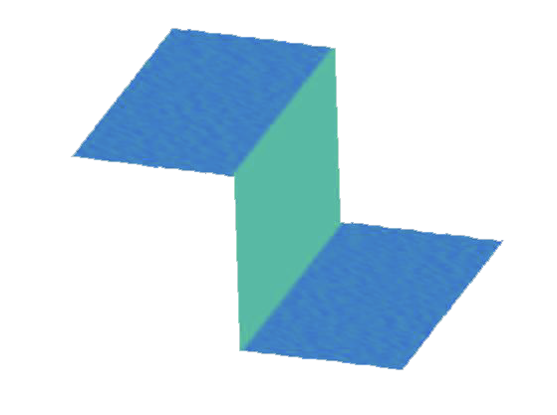
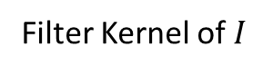
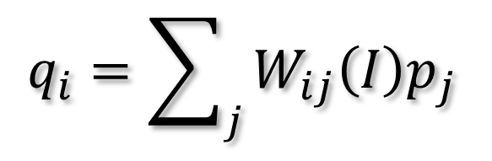
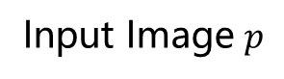
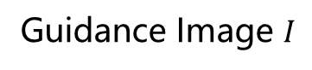
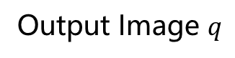
General Linear Translation-Variant Filtering Process
Output Image $q$
$$q_{i}=\sum_{j}{W_{ij}\left(I\right)p_{j}}$$
Input Image $p$
Filter Kernel of $I$
Guidance Image $I$

Slide 12
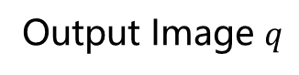
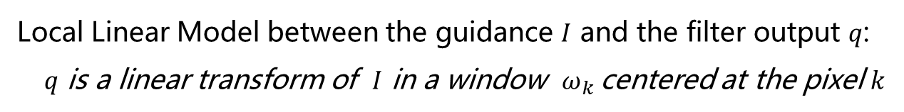
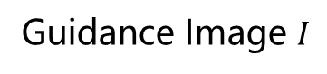
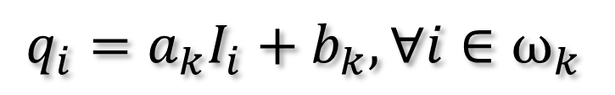
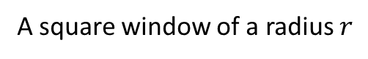
Assumption: Local Linear Model
Local Linear Model between the guidance $I$ and the filter output $q$:
$q$ is a linear transform of $I$ in a window $ω_{k}$centered at the pixel $k$
$$q_{i}=a_{k}I_{i}+b_{k},∀i∈ω_{k}$$
A square window of a radius $r$
Output Image $q$
Guidance Image $I$

Slide 13
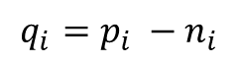
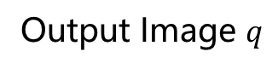
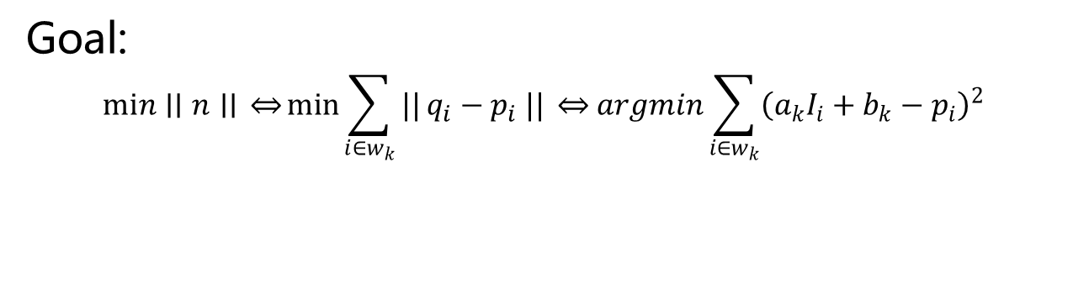
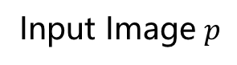
Optimization
Goal:
$$min∣∣n∣∣ \underset{⇔}{ }\min{\sum_{i∈w_{k}}{||}q_{i}−p_{i} ||} \underset{⇔}{ } argmin\sum_{i∈w_{k}}{{\left(a_{k}I_{i}+b_{k}−p_{i}\right)}^{2}}$$
Noise / Texture
$$q_{i}=p_{i} −n_{i}$$
Output Image $q$
Input Image $p$

Slide 14
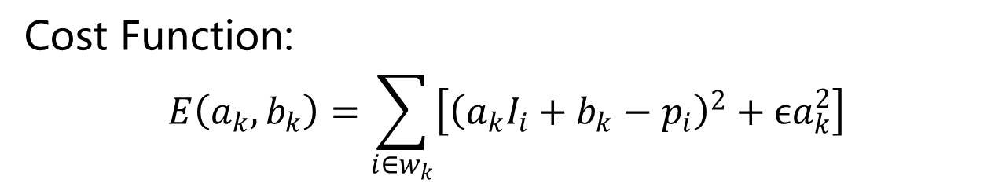
Optimization
Cost Function:
$$E\left(a_{k},b_{k}\right)=\sum_{i∈w_{k}}{\left[{\left(a_{k}I_{i}+b_{k}−p_{i}\right)}^{2}+ϵa_{k}^{2}\right]}$$
Regularization Parameter
$$q_{i}=p_{i} −n_{i}$$
Output Image $q$
Input Image $p$

Slide 15

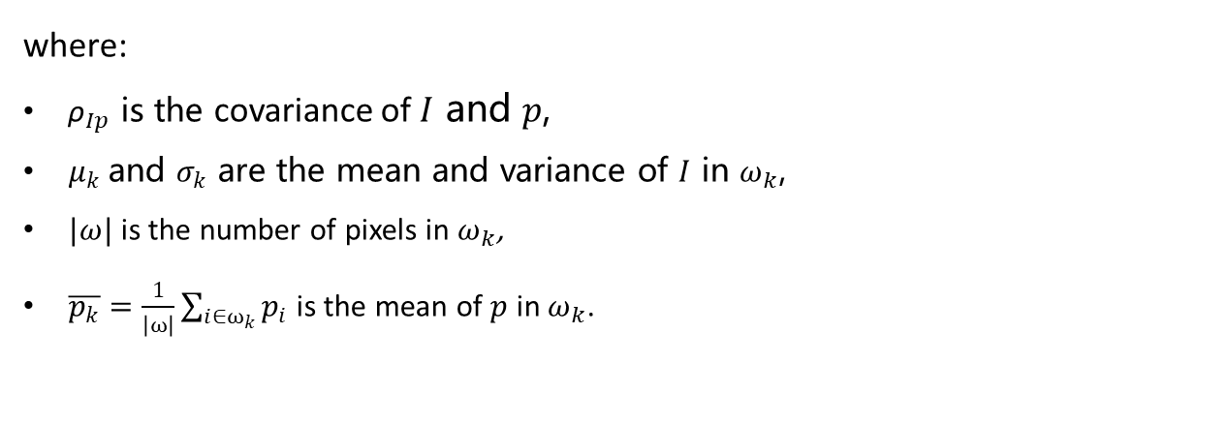
Optimization
Solution:
$a_{k}=\frac{{\text{ρ}}_{Ip}}{σ_{k}^{2}+ϵ}$ $=\frac{\frac{1}{\left|ω\right|}\sum_{i∈ω_{k}}{I_{i}p_{i}}−μ_{k}\overline{p_{k}}}{σ_{k}^{2}+ϵ}$
$$b_{k}=\overline{p_{k}}−a_{k}μ_{k}$$
where:
${\text{ρ}}_{Ip}$ is the covariance of $I$ and $p$,
$μ_{k}$and $σ_{k}$ are the mean and variance of $I$ in $ω_{k}$,
$|ω|$ is the number of pixels in $ω_{k}$,
$\overline{p_{k}}=\frac{1}{\left|ω\right|}\sum_{i∈ω_{k}}{p_{i}}$ is the mean of $p$ in $ω_{k}$.

Slide 16
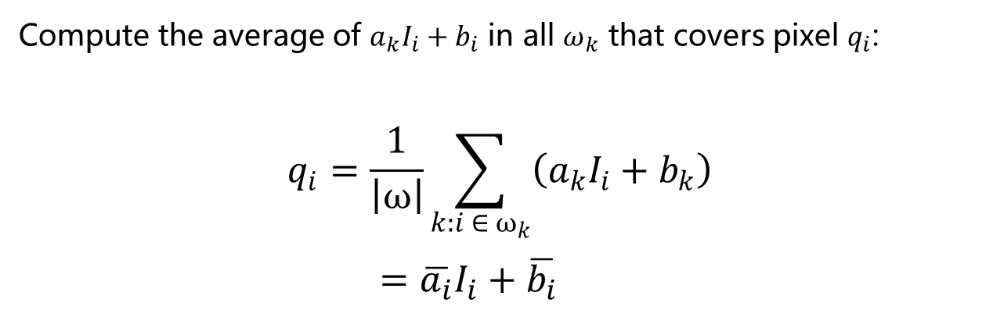
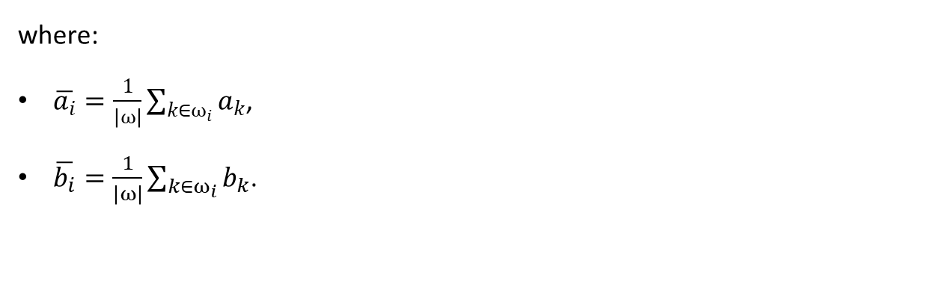
Filter the Entire Image
Compute the average of $a_{k}I_{i}+b_{i}$ in all $ω_{k}$ that covers pixel $q_{i}$:
$$q_{i}=\frac{1}{\left|ω\right|}\sum_{k:i ∈ ω_{k}}{\left(a_{k}I_{i}+b_{k}\right)}$$
$=\overline{a_{i}}I_{i}+\overline{b_{i}}$
where:
$\overline{a_{i}}=\frac{1}{\left|ω\right|}\sum_{k∈ω_{i}}{a_{k}}$,
$\overline{b_{i}}=\frac{1}{\left|ω\right|}\sum_{k∈ω_{i}}{b_{k}}$.

Slide 17

Analysis

Slide 18


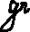
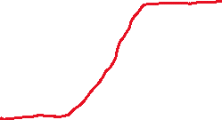



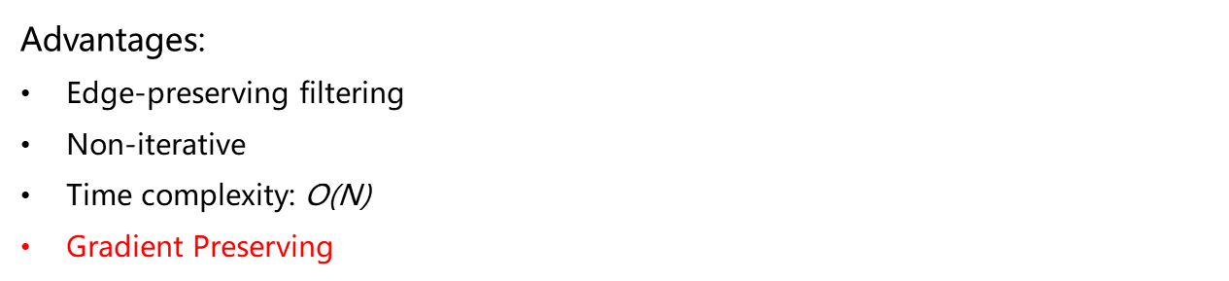


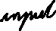
Analysis
Bilateral Filter
Guided Filter
Advantages:
Edge-preserving filtering
Non-iterative
Time complexity: $\text{O}\text{(}\text{N}\text{)}$
Gradient Preserving
Detail
Enhanced

Slide 19
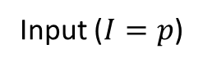
Gradient Preserving
Gradient reversal
Input ($I=p$)
Bilateral Filter
Guided Filter

Slide 20

Feathering
Guide $I$ (size 3000x2000)

Slide 21

Feathering
Filter input $p$ (binary segmentation)

Slide 22
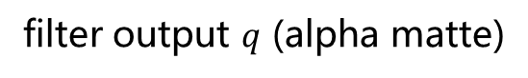
Feathering
filter output $q$ (alpha matte)

Slide 23
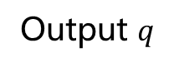
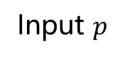
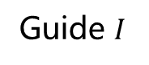
Haze Removing
Guide $I$
Input $p$
Output $q$

Slide 24

3333
Improvements & Conclusions

Slide 25
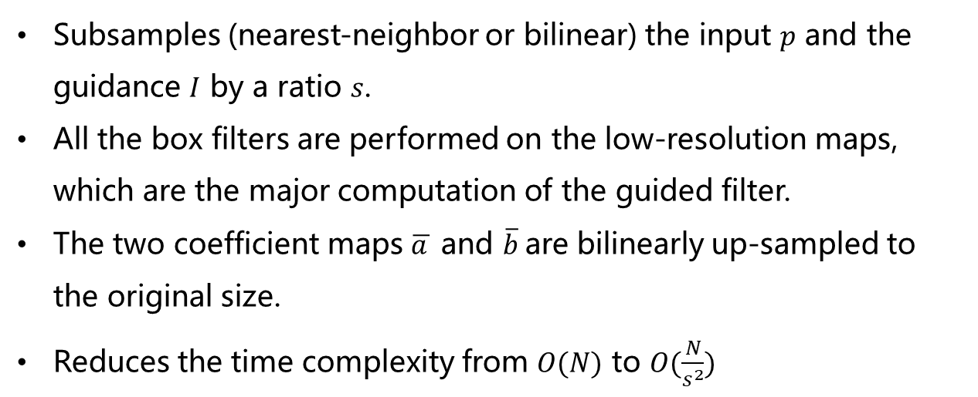
Improvement: Fast Guided Filter
Subsamples (nearest-neighbor or bilinear) the input $p$ and the guidance $I$ by a ratio $s$.
All the box filters are performed on the low-resolution maps, which are the major computation of the guided filter.
The two coefficient maps $\overline{a_{ }}$ and $\overline{b}$are bilinearly up-sampled to the original size.
Reduces the time complexity from $O(N)$ to $O(\frac{N}{s^{2}})$

Slide 26
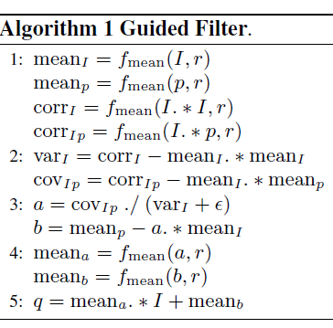
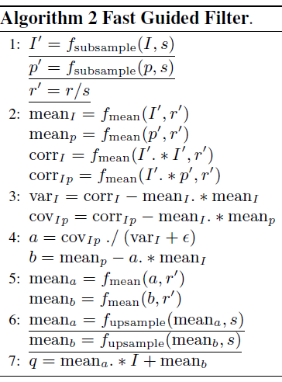
Improvement: Fast Guided Filter

Slide 27
Limitations
Weaker edge
Halo
Stronger texture
Input
Guided filter

Slide 28
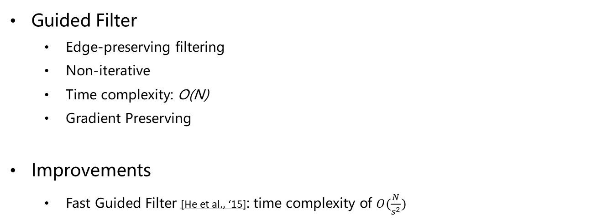
Conclusions
Guided Filter
Edge-preserving filtering
Non-iterative
Time complexity: $\text{O}\text{(}\text{N}\text{)}$
Gradient Preserving
Improvements
Fast Guided Filter [He et al., ‘15]: time complexity of $O(\frac{N}{s^{2}})$

Slide 29

Thank You

